Slide 1
“Encryption and Decryption Using AES Algorithm”

Slide 2

DEPARTMENT OF COMPUTER ENGINEERING G.V. ACHARYA INSTITUTE OF ENGINEERING AND TECHNOLOGY UNIVERSITY OF MUMBAI 2020-2021
A DISSERTATION REPORT ON
“Encryption and Decryption Using AES Algorithm”
GROUP MEMEBERS
Rajshree Borkar (03)
Ashish Gavade (08)
Shubham Khedeker (21)
SK Mohd Amjad Raza (49)

Slide 3

What is Encryption And Decryption ?
Encryption is the process of
translating plain text data (plaintext)
into something that appears to be
random and meaningless (ciphertext).
Decryption is the process of
converting ciphertext back to
plaintext.

Slide 4
Why Use Encryption ?
Encryption is important because it allows you to
securely protect data that you don't want anyone else to
have access to.

Slide 5
What is AES (Advanced Encryption Standard) ?
It is a symmetric block cipher chosen by the U.S. government to protect classified information and is implemented in software and hardware throughout the world to encrypt sensitive data.
It was intended to be easy to implement in hardware and software, as well as in restricted environments

Slide 6
Using AES For Encrypting And Decrypting Text
Encryption
The Code In Our Project,
Converts A Text File Into An
Encrypted File Using Java Code
And AES Algorithm
Decryption
Later, That Encrypted File Can be
Taken To Any Receiving System
And Decrypted To View The
Original Intended Text Using The
Java Code.

Slide 7
ADVANTAGES or Benefits of AES
Following are the benefits or advantages of AES:
As it is implemented in both hardware and software, it is most robust security protocol.
It uses higher length key sizes such as 128, 192 and 256 bits for encryption. Hence it makes AES algorithm more robust against hacking.
It is most common security protocol used for wide various of applications such as wireless communication, financial transactions, e-business, encrypted data storage etc.
It is one of the most spread commercial and open source solutions used all over the world.
No one can hack your personal information.
For 128 bit, about 2128 attempts are needed to break. This makes it very difficult to hack it as a result it is very safe protocol.

Slide 8
Drawbacks or disadvantages of AES
Following are the disadvantages of AES:
It uses too simple algebraic structure.
Every block is always encrypted in the same way.
Hard to implement with software.
AES in counter mode is complex to implement in software taking both performance and security into considerations.

Slide 9
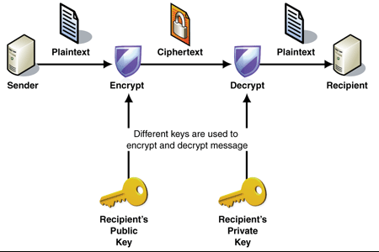
Proposed System
In our system, sender send the plain text, the text which we have to encrypt and we have to set an encryption key for encrypted method. After encryption the cipher text is used for decryption of message in which we have to copy the encrypted message and then enter the key set while encryption and the encrypted message will be decrypted

Slide 10
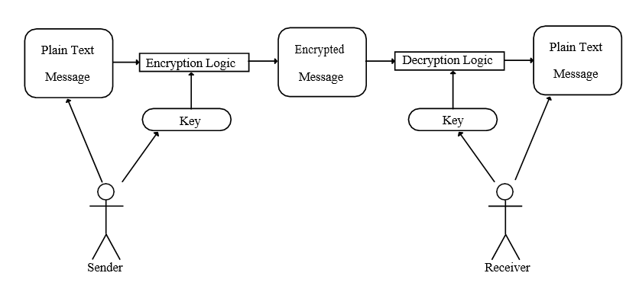
USE-CASE Diagram

Slide 11
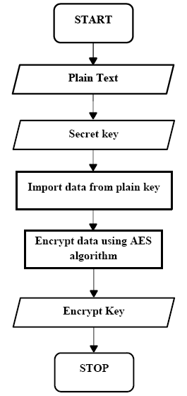
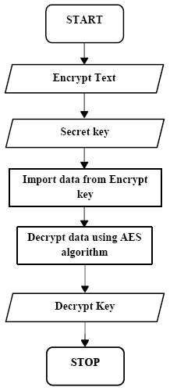
Flow Charts
Encryption:-
Decryption:-

Slide 12
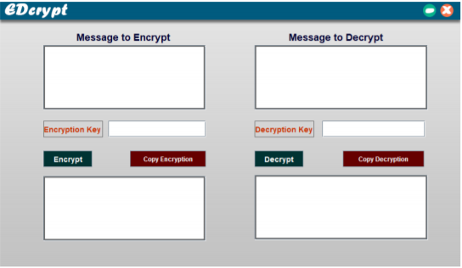
Implementation Snapshot's
Main
Output
Window

Slide 13
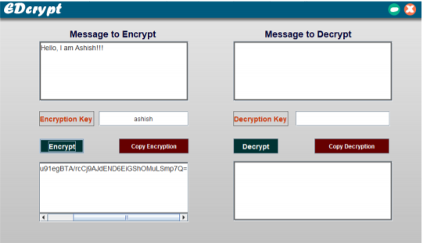
Implementation Snapshot's
Message
And
Key
for
Encryption

Slide 14
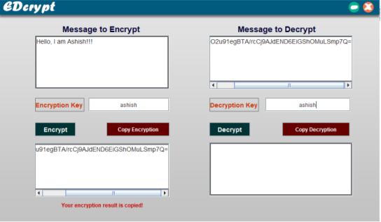
Implementation Snapshot's
Encrypted
Message
and
Secret
Key
For
Decryption

Slide 15
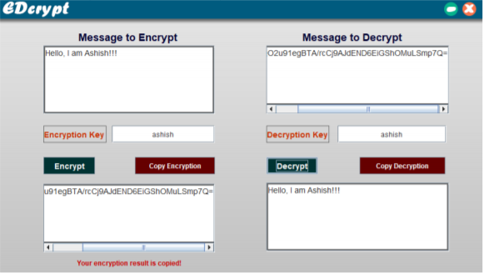
Implementation Snapshot's
Final
Decrypted
Message

Slide 16
Conclusion
It can be concluded that this project works efficiently for offline purpose at any place provided
the requirements for running environment remains same.
Users need not to worry about how the algorithm actually works inside the instruction set performed by the compiler.

Slide 17
Reference
Yenuguvanilanka. J., & Elkeelany, O. (2008. April). Performance evaluation of hardware models of Advanced Encryption Standard (AES) algorithm. In Southeastcon, 2008. IEEE (pp. 222-225).
“AES Website”, https://en.wikipedia.org/wiki/Advanced_Encryption_Standard
“Java Website”, http://www.en.wikipedia.org/wiki/Java(Programming_language)
Lu. C. C.. & Tseng, S. Y. (2002). Integrated design of AES (Advanced Encryption Standard) encrypter and decrypted. In Application-Specific Systems. Architectures and Processors. 2002. Proceedings. The IEEE International Conference on (pp. 277-285).

Slide 18
Thank You..

